Slide 1



Bike Sharing System
rent the bicycle and return to the different place for the bike sharing purpose
Team13： 황자신 어즉민 이건희

Slide 2
01
Find a problem
CONTENTS
02
Analyze previous approaches
03
Modeling new methodology
04
Analyzing data
05
Visualization

Slide 3
1: Find a problem
Find a problem (Research target):
We wanted to find out what factors affect the number of bikes shared.

Slide 4
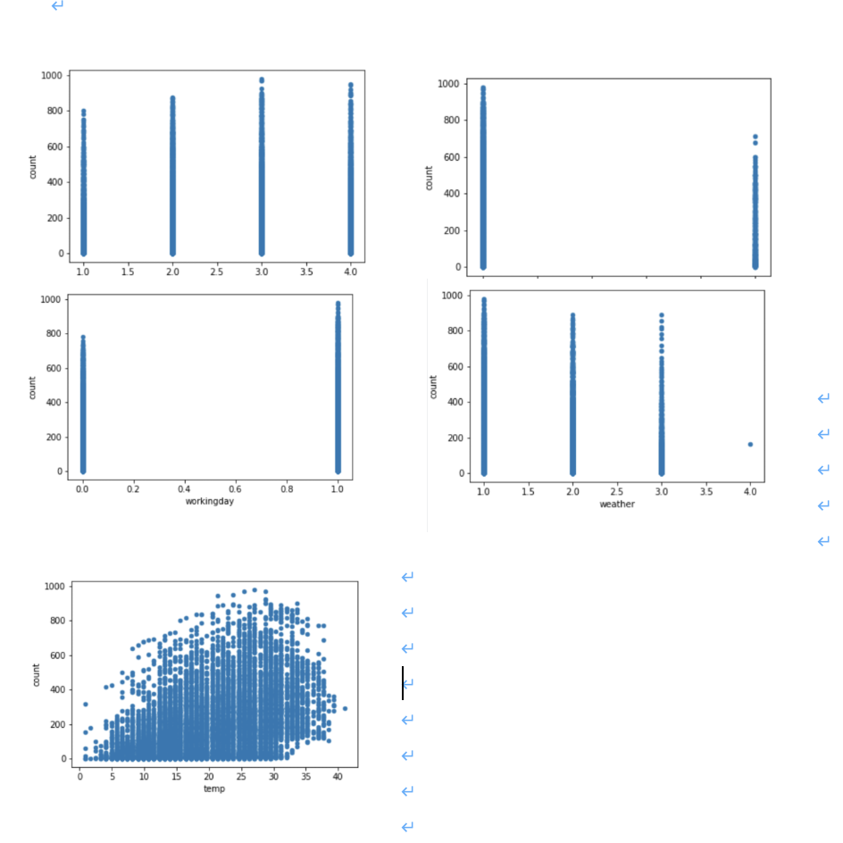
2: Analyze previous approaches
Source of code: https://www.kaggle.com/deeprajbasu/exploringbikesharingdata
DEEPRAJ BASU uploaded 2 years ago
Step1: The author used separate statistics of seasons, holidays, working days, weather, windspeed and temperature to make charts. There are some examples.

Slide 5
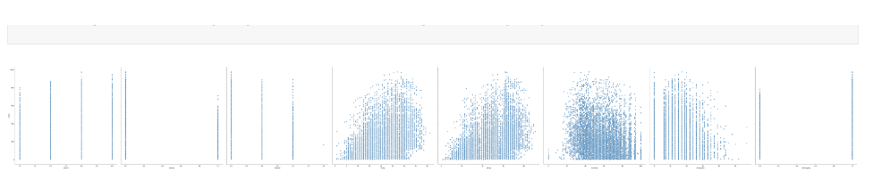
2: Analyze previous approaches
Integrated data graph result

Slide 6
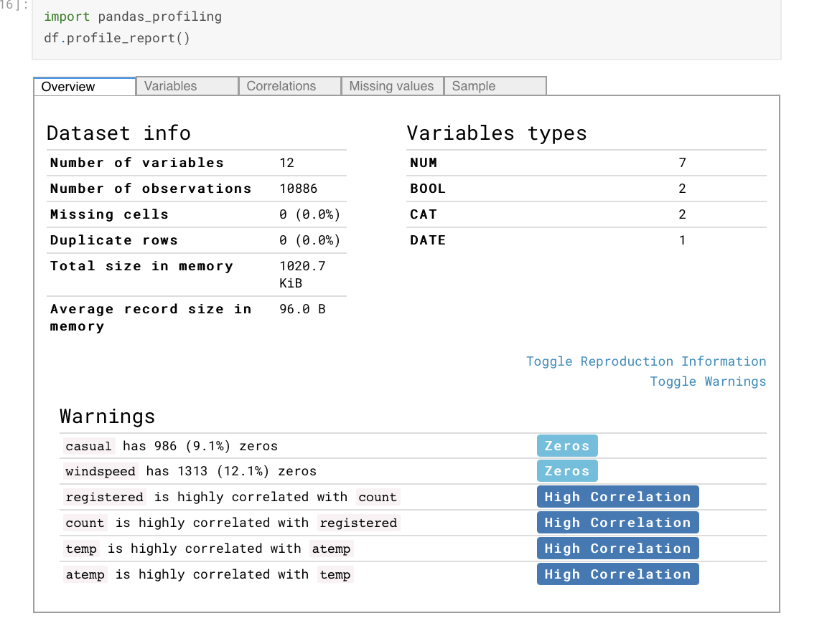
2: Analyze previous approaches
Step2: Use Pandas_profiling to exploring data

Slide 7
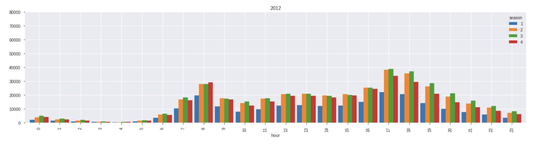
2: Analyze previous approaches
Step3: Visualizing the date time
The author used data from 2012 as a reference and hoped to get effective information from it.
The time in the date data is extracted in units of hours to judge the peak period of shared
bike use.

Slide 8
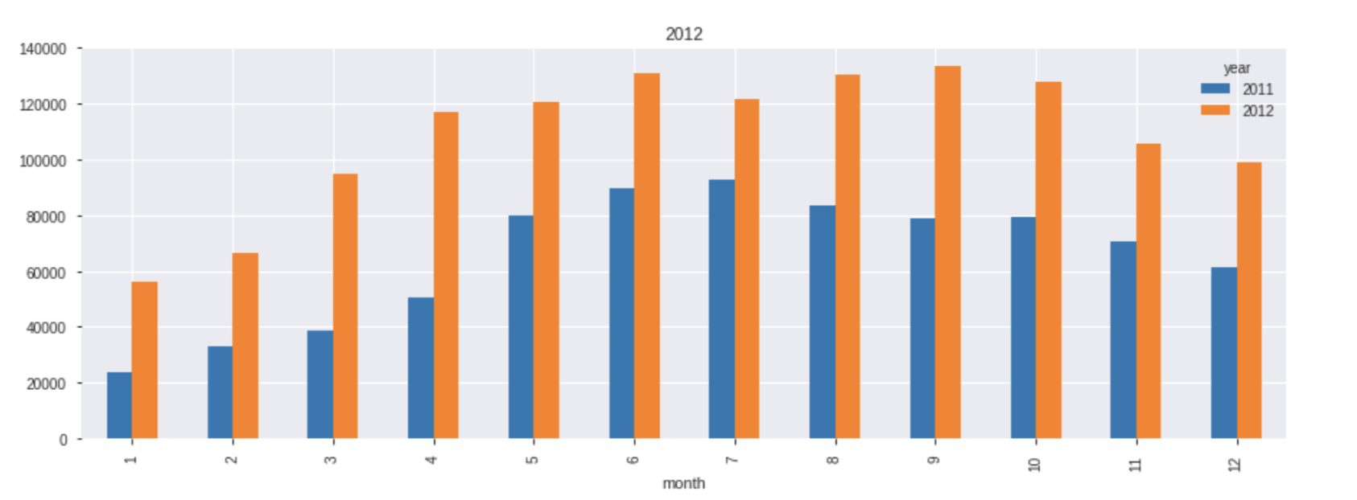
2: Analyze previous approaches
Step3: Visualizing the date time
The author used data from 2012 as a reference and hoped to get effective information from it.
The time in the date data is extracted in monthly units to judge the peak period of shared bike use.

Slide 9
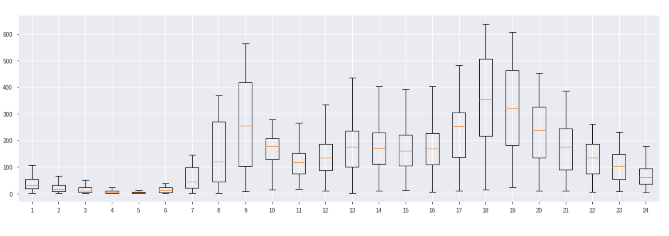
2: Analyze previous approaches
Convert data representations to box plots. The purpose of using a box plot is to see how the data is distributed, to see where the data is concentrated, what the characteristics of the distribution are, whether the data is concentrated on the side of the smaller value or the side of the larger value.

Slide 10
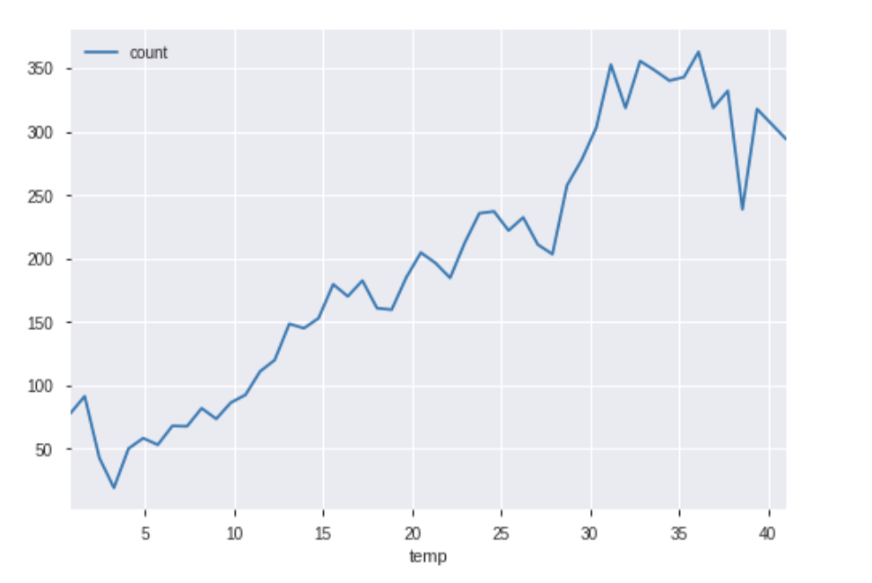
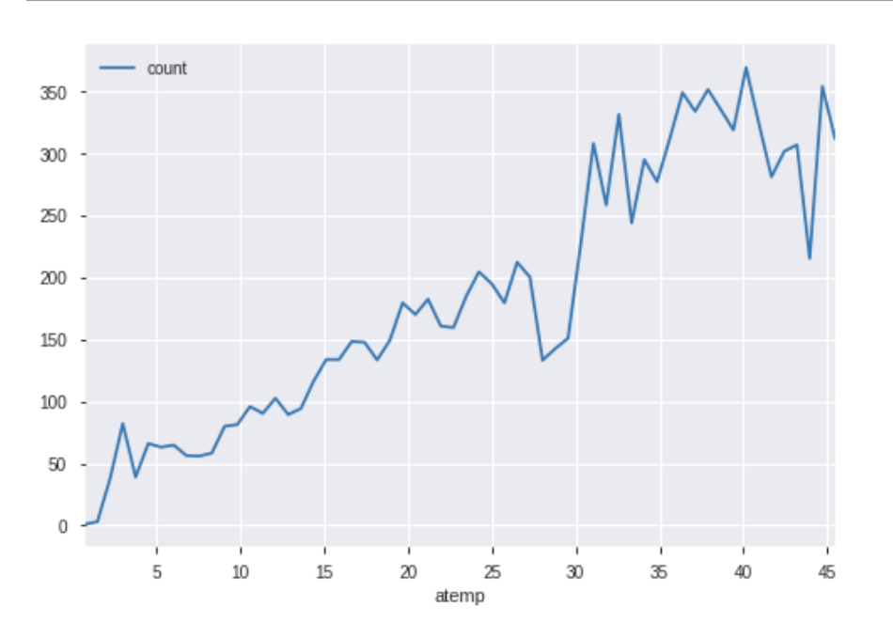
2: Analyze previous approaches
Step4：Use line plot to guess bike demand

Slide 11
3: Modeling new methodology
survey general existing approach , algorithms
Previous version: use Pandas_profiling, generate box plot
Our team: Non-parametric test, Hypothesis test, calculate correlation coefficient，random forest algorithm
relevance of the presented differentiation
Previous version: The first step is to chart the data separately. In the absence of a definite correlation, conclusions are unconvincing. Then the last step of bike demand prediction, which only studies the two influencing factors of temperature and body temperature.
Our team: We want to improve the following three points. The first is to check whether there are a lot of outliers. The second point is to use hypothesis testing to find out the potential influencing factors. The third point is to determine whether the correlation is strong.

Slide 12
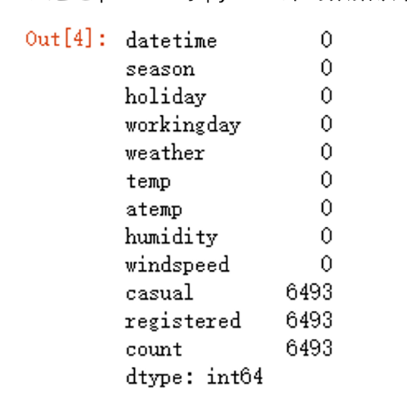
4: Analyzing Data
Extract the database.
There is no null value in the visible data. The casual, registered and count in the test set need to be filled after we make predictions later.

Slide 13
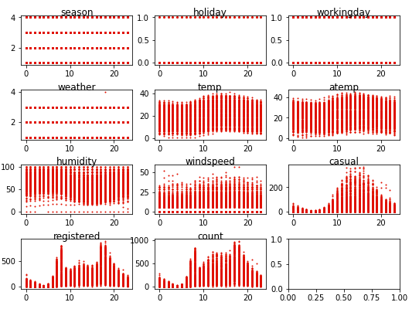
4: Analyzing Data
Data observation
Scatter plots were drawn by Matplotlib and Seaborn to observe the distribution of data.

Slide 14
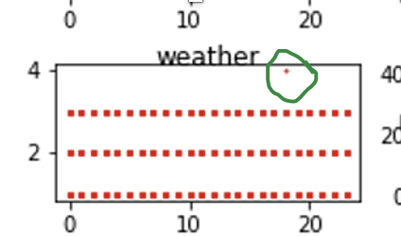
4: Analyzing Data
Data observation
We find there is one extreme data in weather graph.
After our inspection, this data is real extreme weather.
.

Slide 15
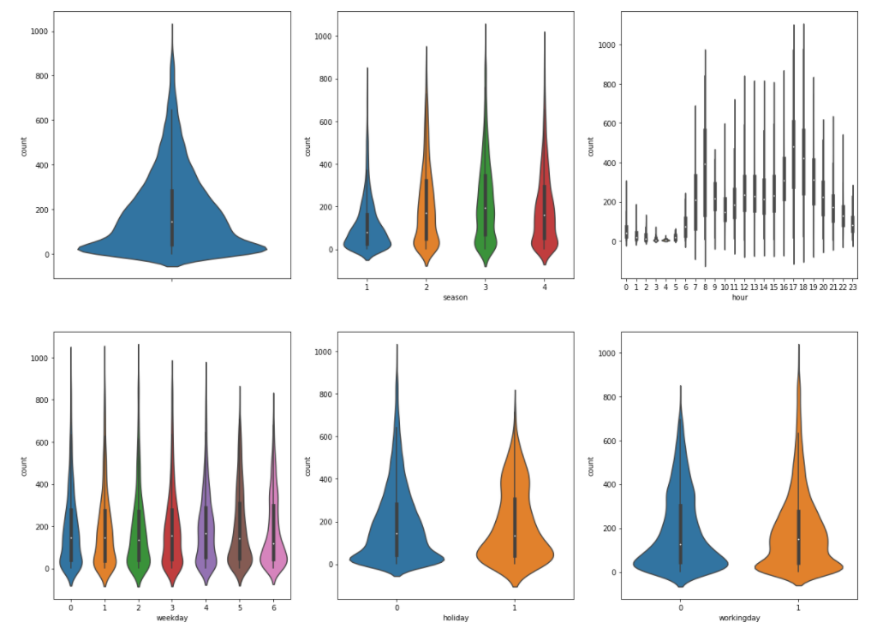
4: Analyzing Data
Data observation
Butterfly plots were drawn by Matplotlib and Seaborn to observe the distribution of data.
We didn't find many outliers, the data for the whole dataset is reasonable.
Our conclusions are as follows
1) There are some outliers in spring and winter.
2) In the hourly chart, there are some outliers before noon.

Slide 16
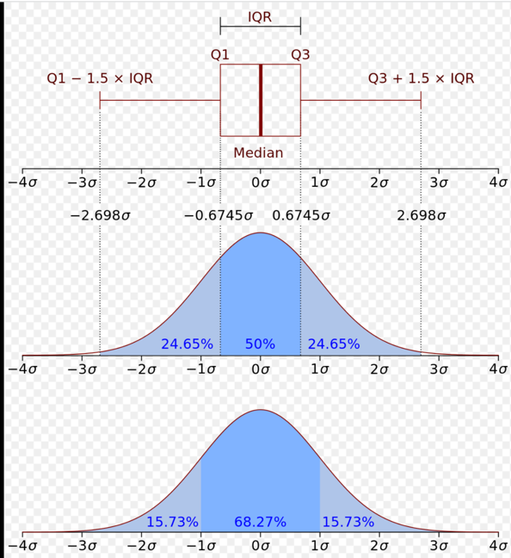
4: Analyzing Data
Handle outliers
Remove outliers by determining upper and lower limits. After processing, the data will be reduced by 100 to 300 entries
The upper and lower limits we set: Inter Quartile Range +/- 2IQR

Slide 17
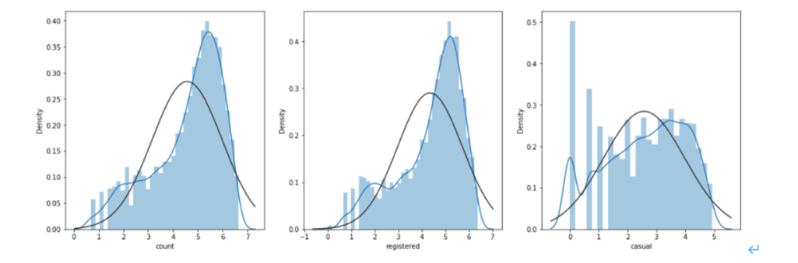
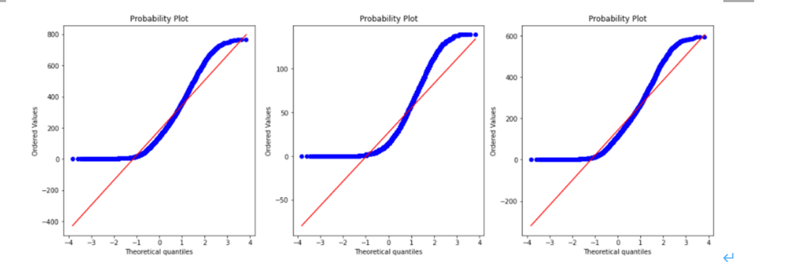
4: Analyzing Data
Determine if the casual, registered, count is normally distributed.
.
We compare the resulting graphs with the standard normal distribution graphs and find that these graphs show a short-tailed distribution. The pattern formed by the dots is curved above the line on the left and below the line on the right. This shows that the data is more concentrated closer to the mean than the standard normal distribution.

Slide 18
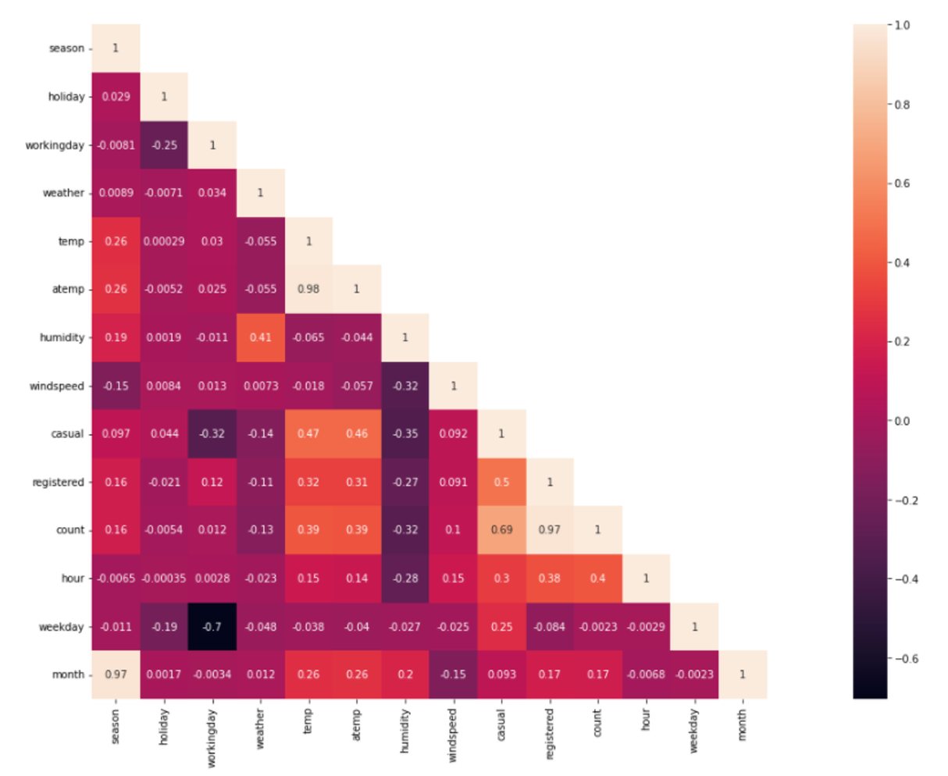
5: Visualization
Hypothesis testing and Calculate correlation coefficient
We assume that the sample is normally distributed. If the hypothesis is true, the value should be close to 1. If the hypothesis is not met, the value is close to zero.

Slide 19
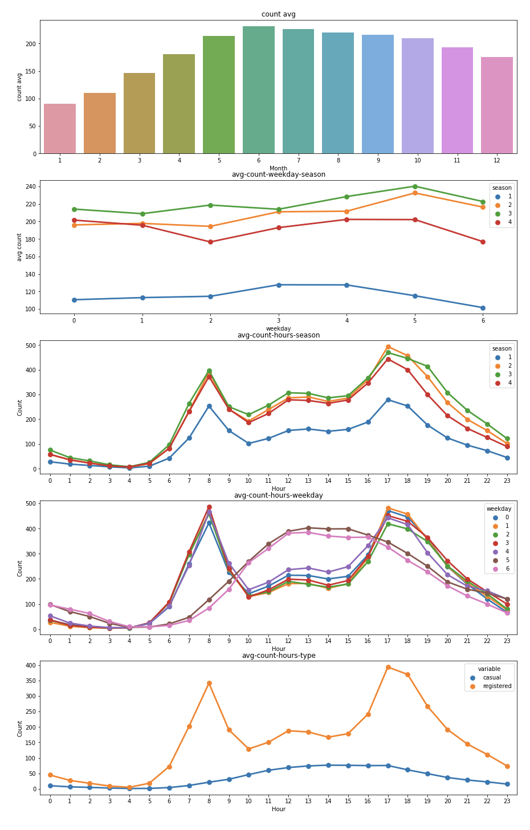
5: Visualization
The number of users
Average monthly users: 6, 7, 8
The number of weekly users in four seasons is the highest in summer and autumn, the lowest in spring, and the lowest on Wednesday
Most people use it during rush hour every day
Correlation between the number of users and climate characteristics:
The body temperature (atemp), non-registered users (casual) and registered users (registered) had a strong positive correlation, while the negative correlation with humidity was obvious, and had no obvious relationship with wind speed

Slide 20
5: Visualization
Modeling with random forest algorithm
Model explanation
model_casual: Random Forest models that use meteorological characteristics, time training to predict casual values.
model_registered: Random Forest models that use meteorological characteristics, time training to predict registered values.
model_count: Random Forest models that use meteorological characteristics, time training to predict count values.
Result explanation
The trained model was used to fill the three fields casual, registered and count in the test data set, and the final scatter chart was drawn as follows. The final result is a 3-row, 12-column diagram. The first line shows a predicted scatter chart for casual results for all months, the second line shows a predicted scatter chart for registered results and the third line shows a predicted scatter chart for count results. We found that the predicted results were consistent with the distribution characteristics of the training data set

Slide 21
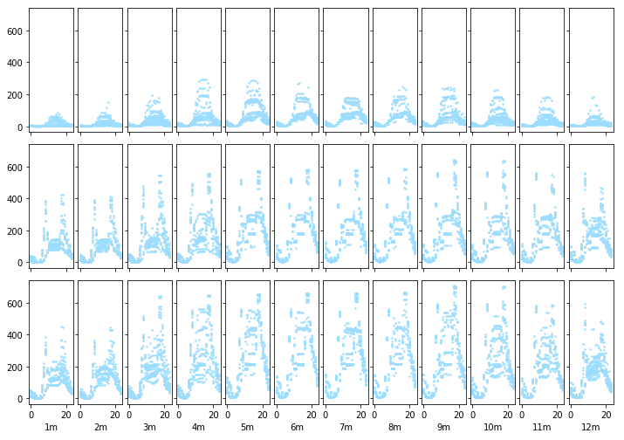
5: Visualization
Modeling with random forest algorithm

Slide 22
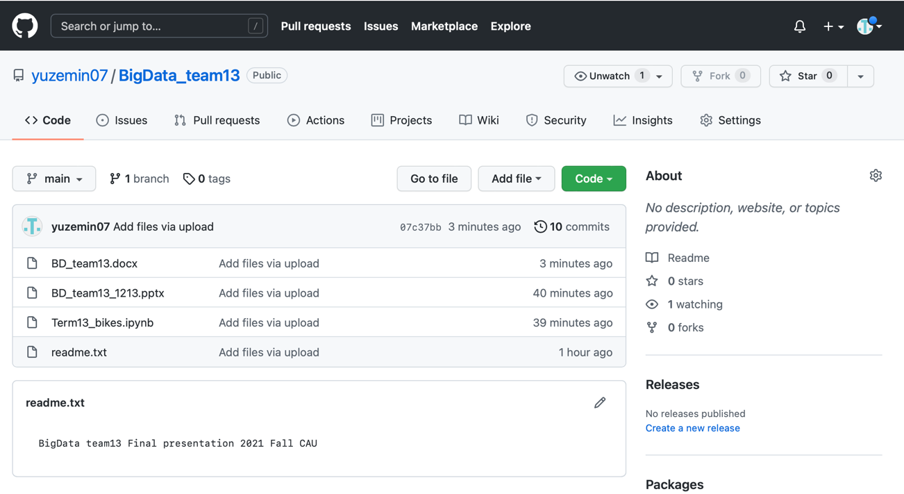
Collaborative evaluation
We finally decided this topic after consulting relevant materials and data sets in the early stage. 어즉민 is responsible for the previous approaches analysis and reports, 황자신is responsible for data analysis and prediction of random forest algorithm, and이건희 took part in coding, algorithm recommendation and preparation for final publication. Although there were some difficulties in decision-making during the project, we communicated with each other with delay and finally completed the project
Github Link：https://github.com/yuzemin07/BigData_team13

Slide 23
Thank you for watching

